Slide 1

AIRBNB hotel booking analysis CARD
DHARSHINI PRAJA

Slide 2

PROBLEM STATEMENT
The hospitality industry has undergone a significant transformation with the rise of online platforms facilitating short-term lodging and tourism Leading this revolution is Airbnb, Inc., a pioneering American company that has reshaped travel accommodation through its innovative online marketplace. Established in 2008 in San Francisco, California, Airbnb provides a diverse range of lodging options, offering guests a unique and personalized experience. Unlike traditional hospitality providers, Airbnb operates on a commission based model, facilitating transactions between hosts and guests without owning the properties listed on its platform.
This research analysis delves into the New York City Airbnb dataset to extract meaningful insights. Through rigorous data cleaning, exploratory analysis, and visualization techniques, the study aims to illuminate the dynamics of the city's lodging market. By discerning factors influencing listing availability, pricing strategies, and overall customer satisfaction, the research contributes to a deeper understanding of Airbnb's operations in one of the world's most dynamic urban environments. These insights hold significance for stakeholders and enthusiasts seeking to navigate the evolving landscape of short-term accommodation.

Slide 3
Analyze Airbnb listings to uncover trends in pricing, host behavior, and guest preferences. Focus on neighborhood distribution, room types, and average prices. Explore top hosts, verified identities, and review patterns. Aim: Provide insights for hosts, guests, and Airbnb management to make data-driven decisions. Tools Used: Python, Pandas, Matplotlib, Seaborn, Google Colab.

Slide 4

THE END USERS :
Primary End Users:
Airbnb Hosts – Optimize pricing, improve listing visibility, and attract more bookings.
Airbnb Guests – Make informed decisions by understanding neighborhood trends, prices, and reviews.
Airbnb Management – Analyze platform performance, monitor host activity, and improve overall customer experience.
Secondary End Users:
Researchers & Analysts – Study trends in the short-term rental market.
Tourism Industry Stakeholders – Gain insights into city lodging patterns and demand hotspots.

Slide 5

Technology Used
Programming & Data Analysis:
Python – Main language for data processing and analysis.
Pandas – Data cleaning, manipulation, and aggregation.
NumPy – Numerical operations and handling arrays.
Data Visualization:
Matplotlib – Creating line, bar, and scatter plots.
Seaborn – Advanced statistical visualizations for insights.
Platform & Tools:
Google Colab – Cloud-based Python environment for coding and running the project.
Excel / CSV Files – Source dataset for Airbnb listings.

Slide 6
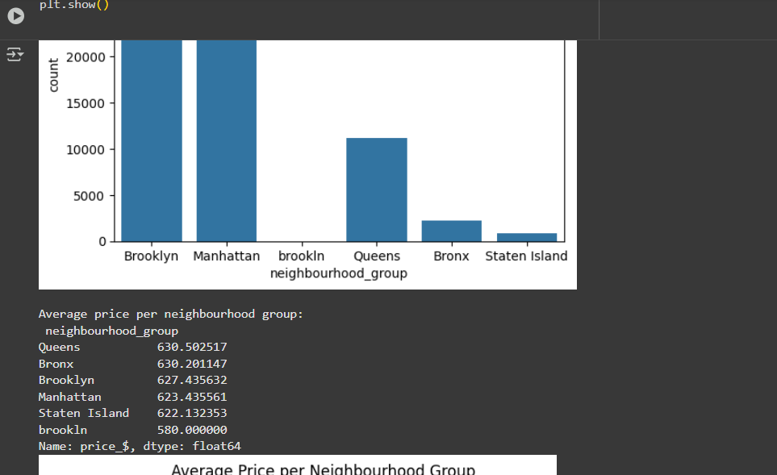
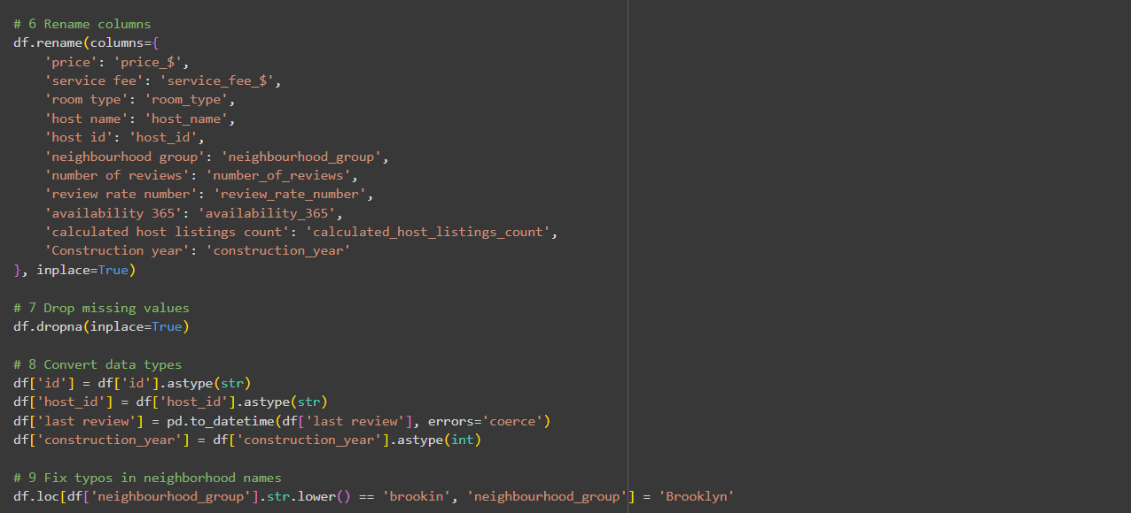
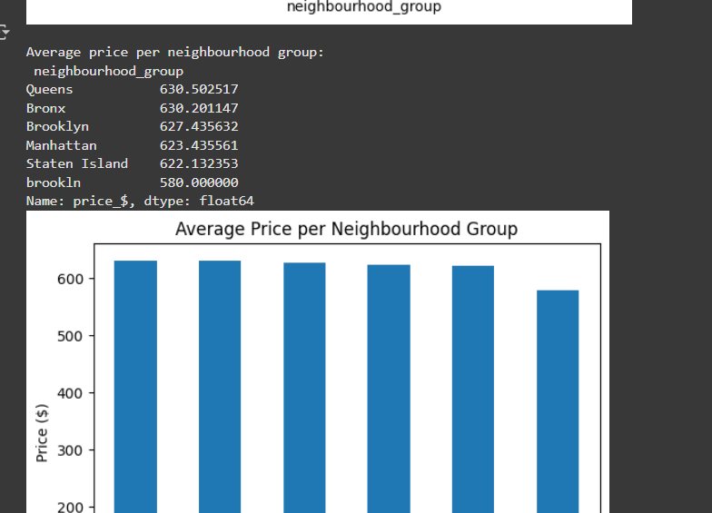
RESULTS
https://github.com/dharshinipraja/VOIS_AICTE_Oct2025_DHARSHINIPRAJA/blob/main/dharshinipraja.ipynb

Slide 7
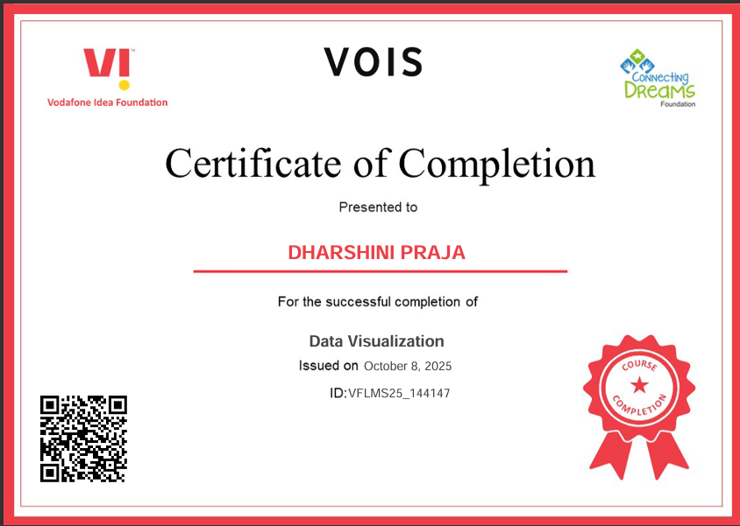

Thank you
.
.

